Slide 1
DR. MED
Multi functioning and fully personalized medical application

Slide 2
Problems
Problem 1
The sudden hit and continuation of the pandemic forced people to stay home and going to hospitals became a risk.
Problem 2
People under so many medications are prone to slight memory loss and hence might forget to take medicines in time.
Problem 3
Search engines provide inaccurate results while searching for diseases based on symptoms hence misguiding people
Healthcare services in the time of the pandemic
Memory loss due to multiple medications
Wrong disease predictions through symptoms

Slide 3
Solution 1
Solutions
Booking doctor's appointments
Reminder system
Symptom analysis by medical practitioners
Online booking through the app for meeting doctors personally or consulting online
Solution 2
Provision to set reminders for taking medication and appointments
Finding prescribed medication for the user's symptoms by recognized medical practitioners
Solution 3

Slide 4

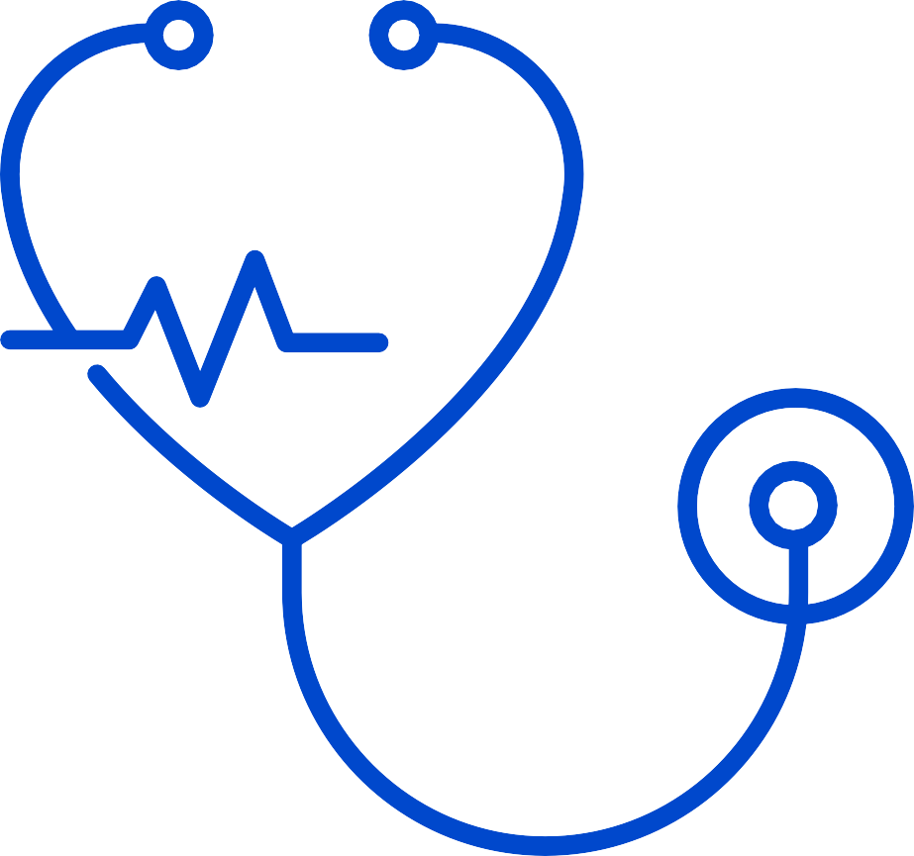

The Application
The Dr.Med application provides a fully personalized service for the users. The app provides various facilities through which you can seek professional medical help just by staying home.
The features are not limited to professional services. We include personal healthcare services and connections with other applications

Slide 5
Reason 1
The rapid rise of the pandemic resulted in difficulty in accessing and providing healthcare services
Timing
Why is now the best timing for such an application?
Reason 2
Necessity and convenience to keep all the health records intact and easily accessible
Reason 3
Increased anxiety among people due to unprofessional symptom search results

Slide 6
1. Reminders
App Features

Slide 7
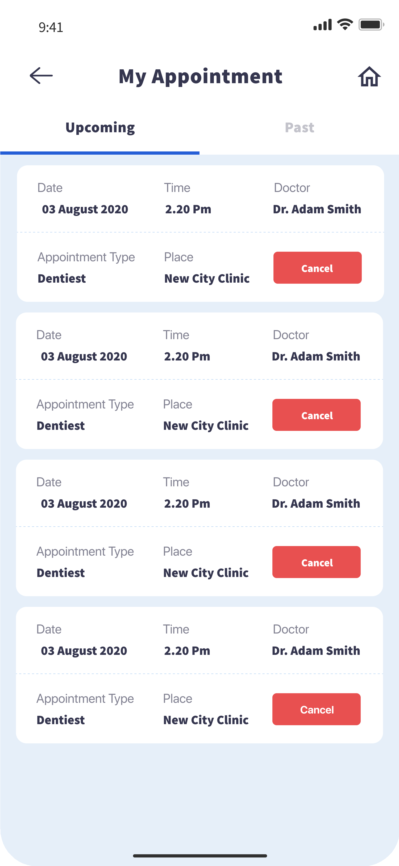
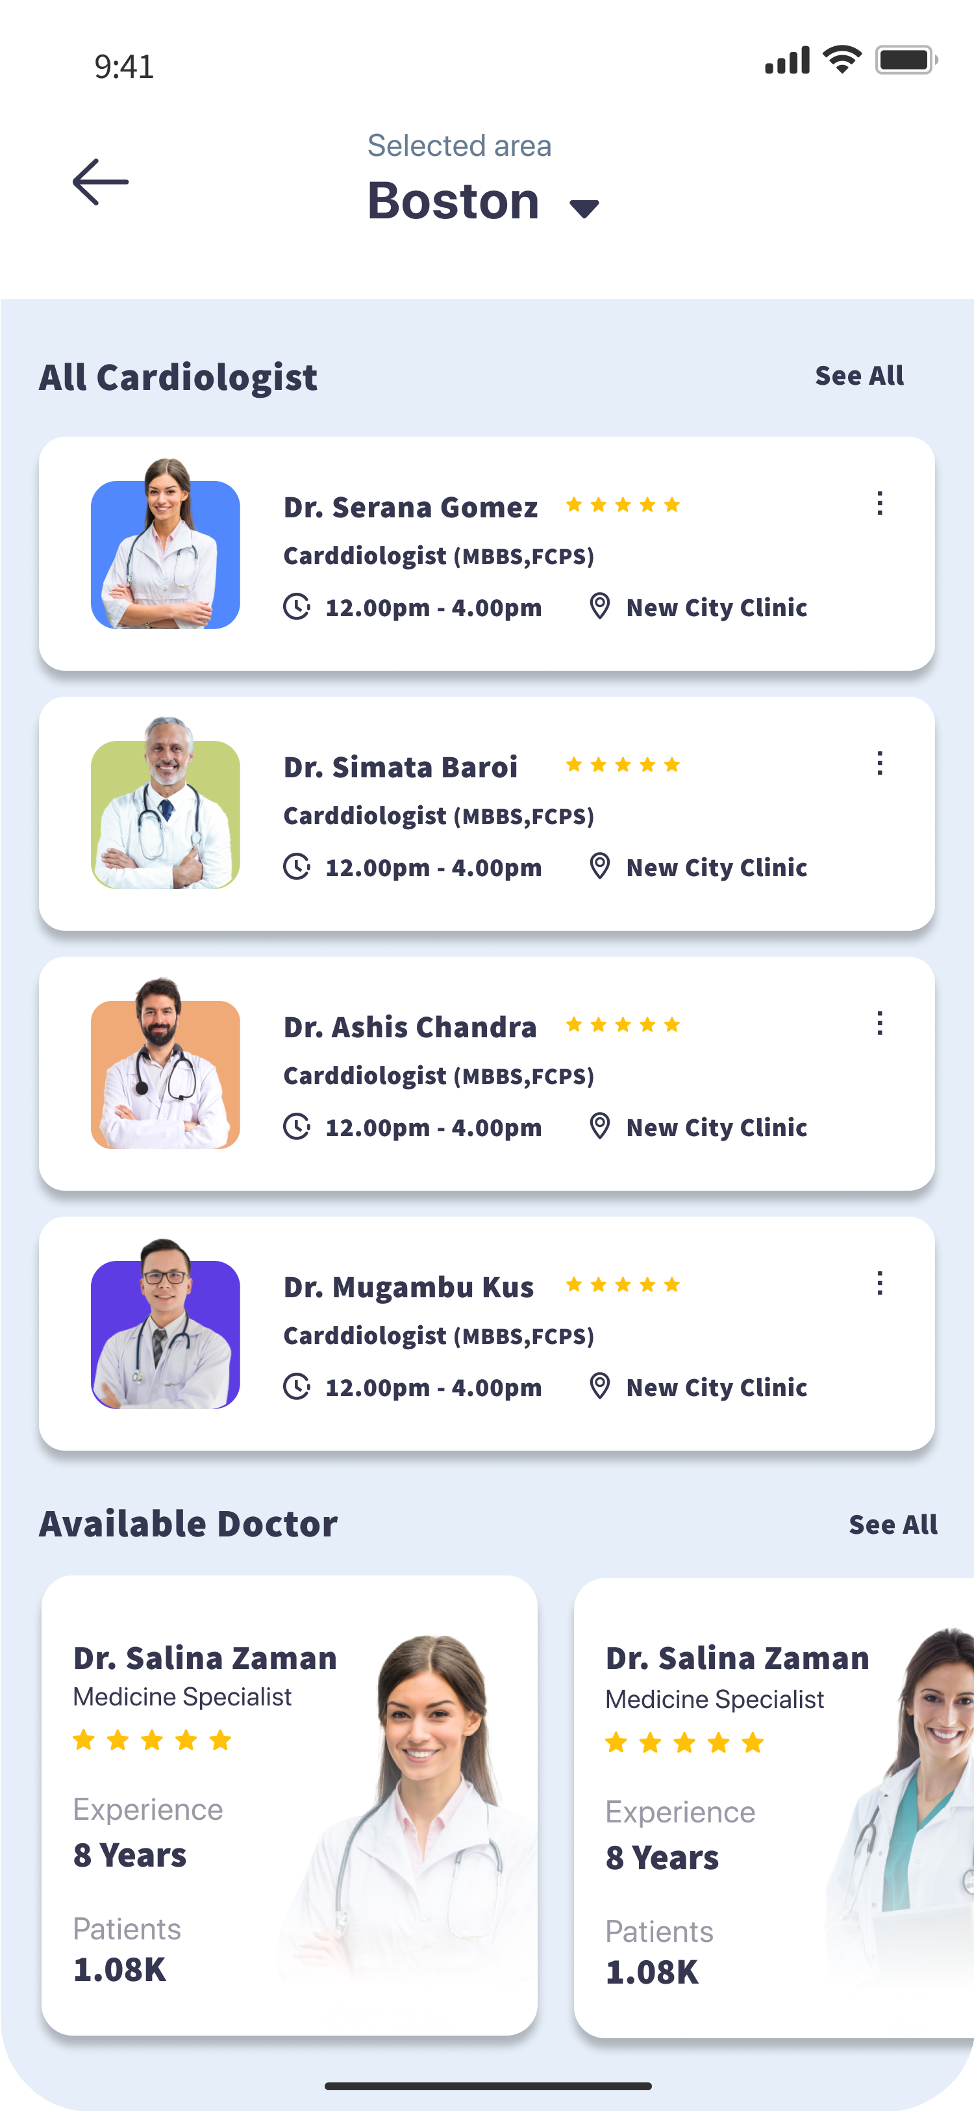
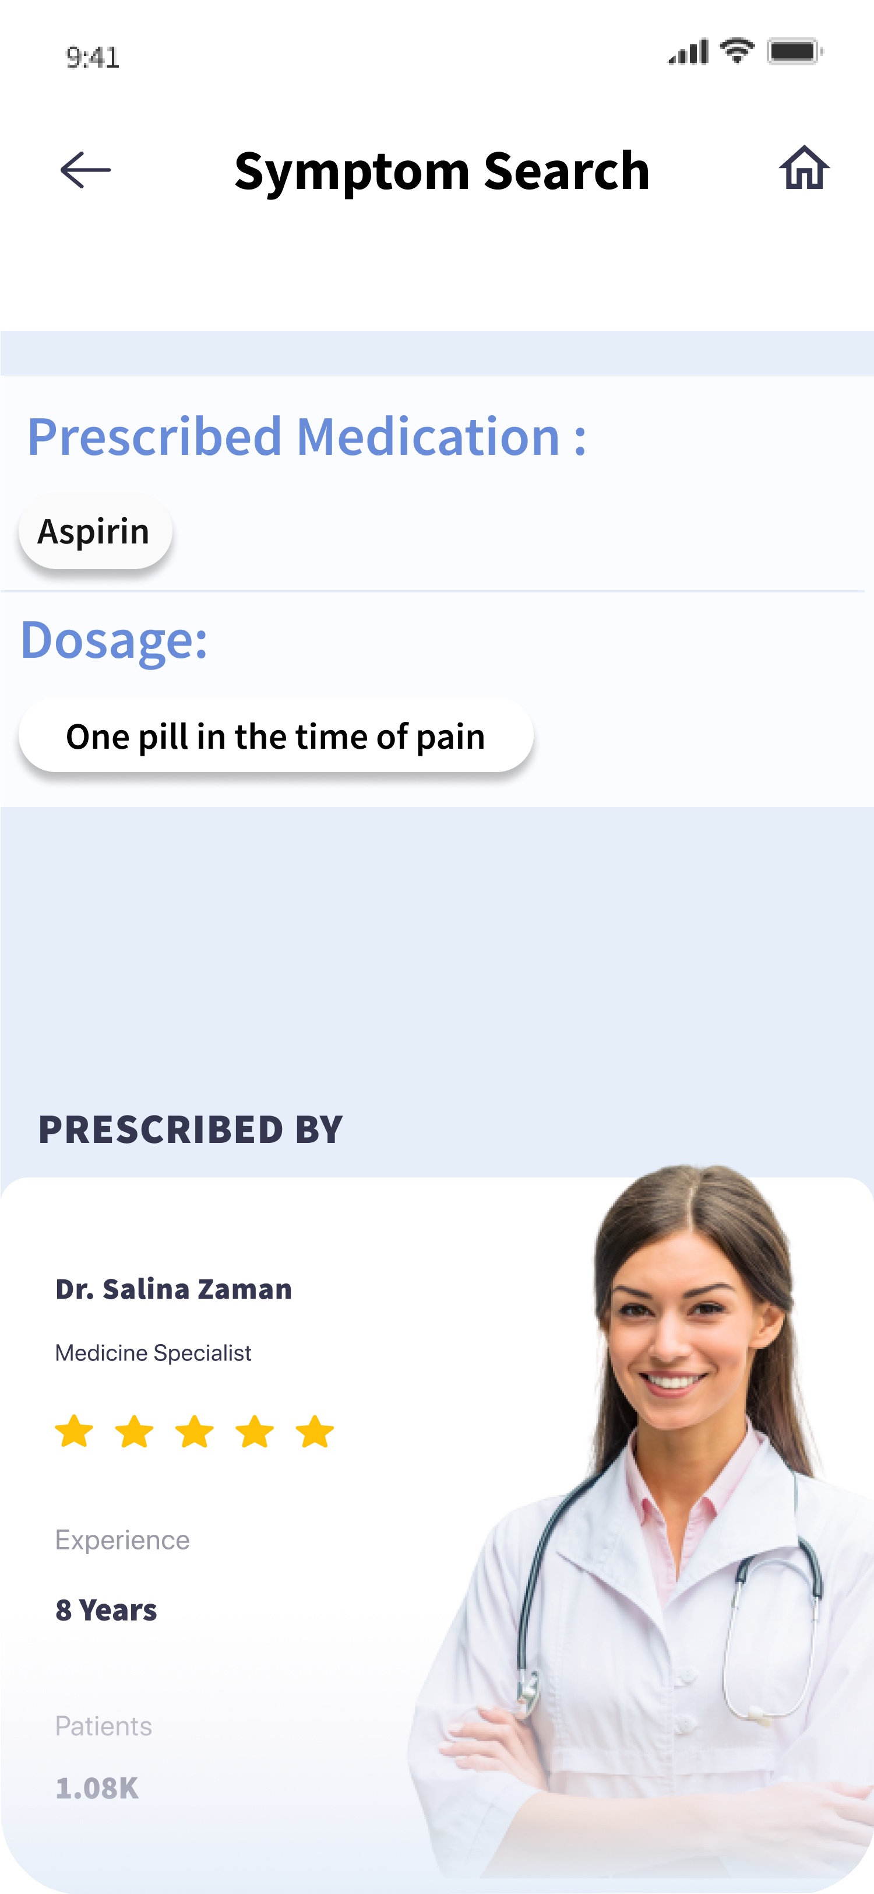
3. Find the right professional
2. Setting up Appointments
4. Symptom Search

Slide 8
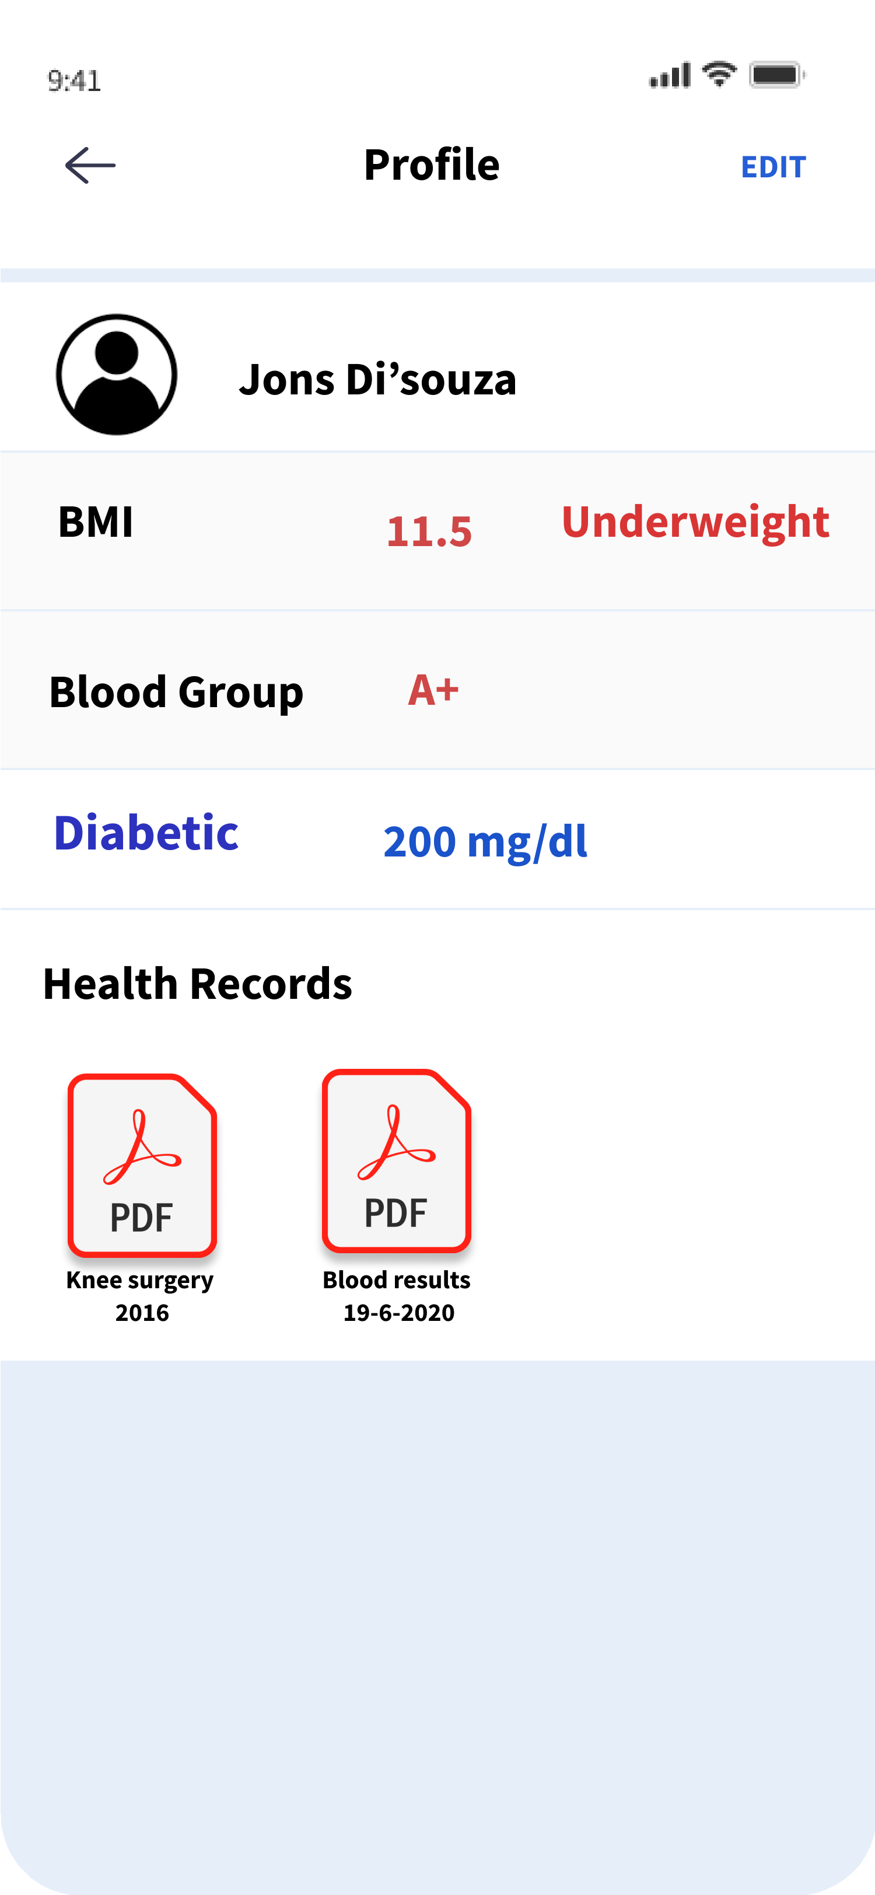
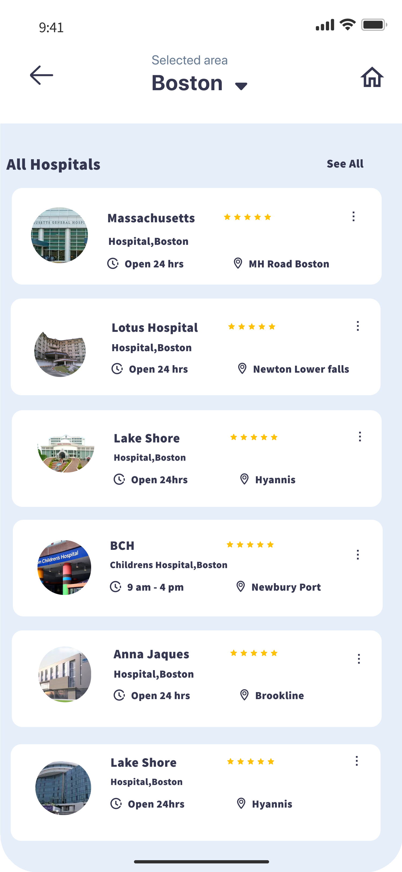
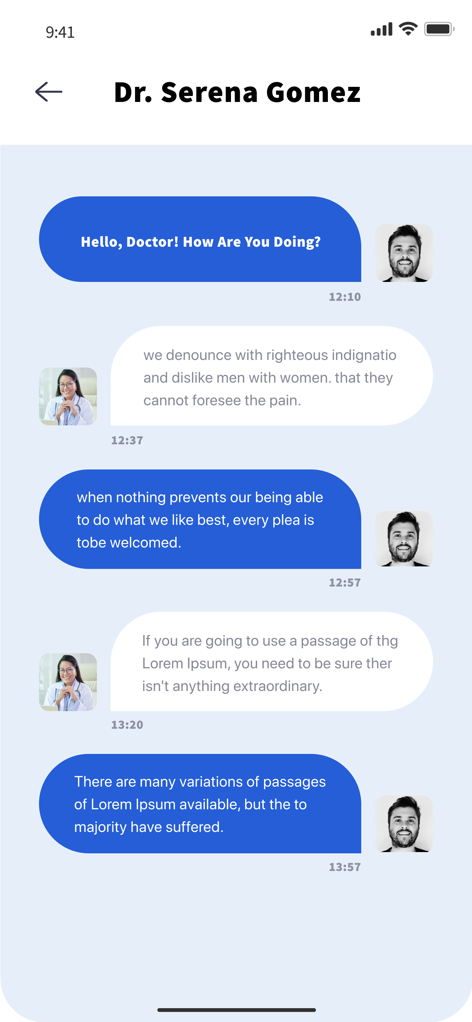
7. Storing essential health records
5. Find the hospital
6. Online Consultation

Slide 9
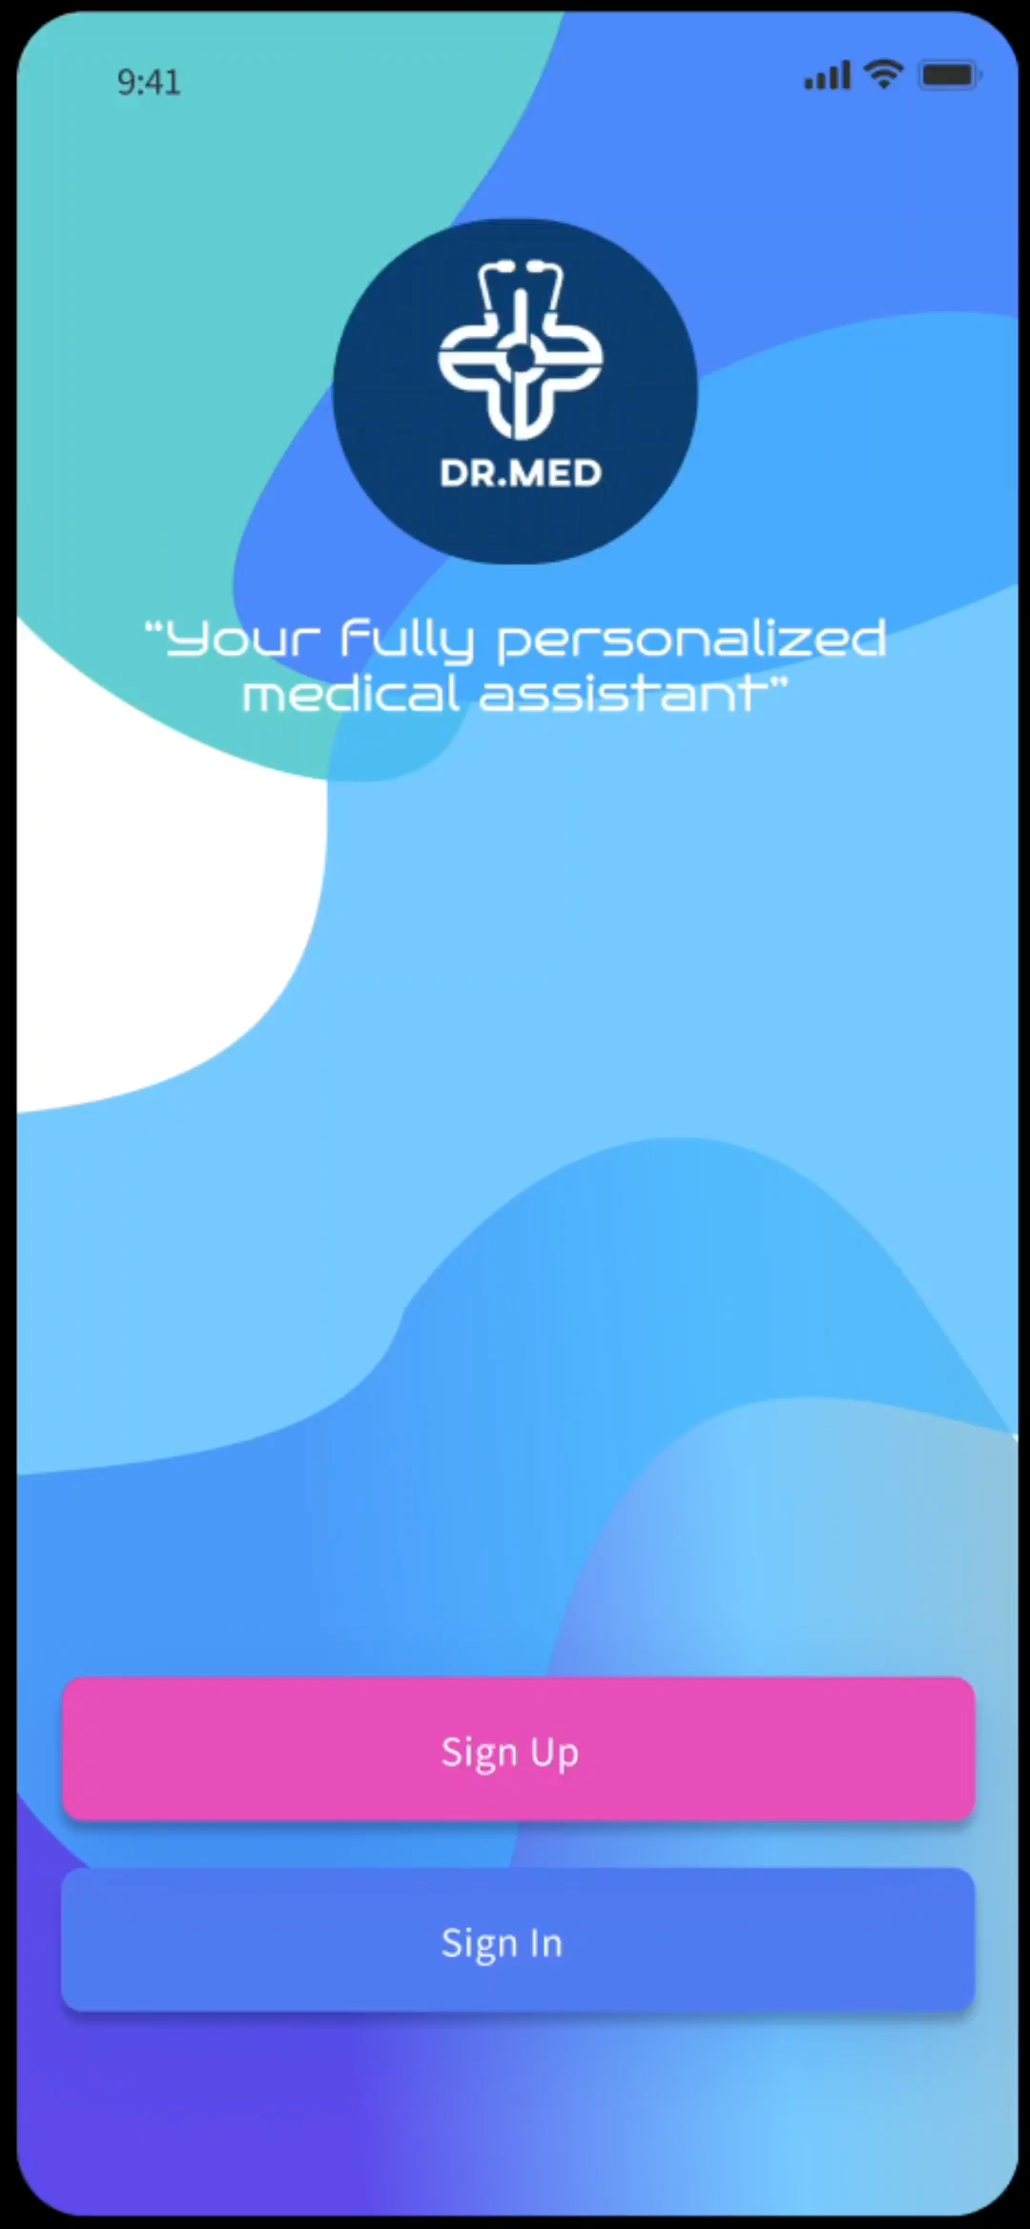
Video Presentation - Design

Slide 10
Technology Stack
FRONT END
FLUTTER
DESIGN
FIGMA

Slide 11
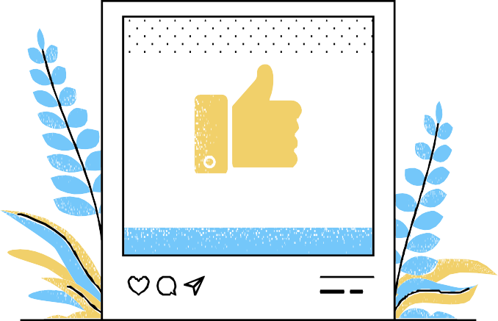
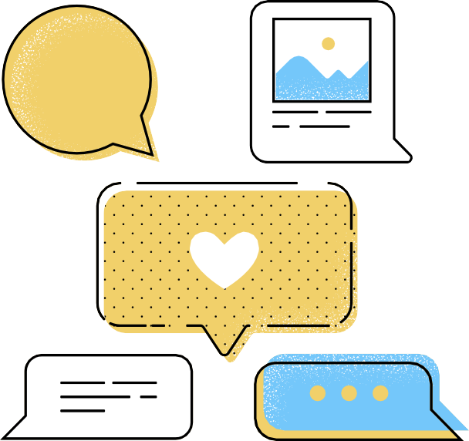
Target Market 1
People with chronic illness or who are under constant medications
Target Market 2
People who underwent surgeries or has health records that needs timely access
Target Market
Our target market mainly focuses on health- conscious people who are adamant about professional assistance

Slide 12
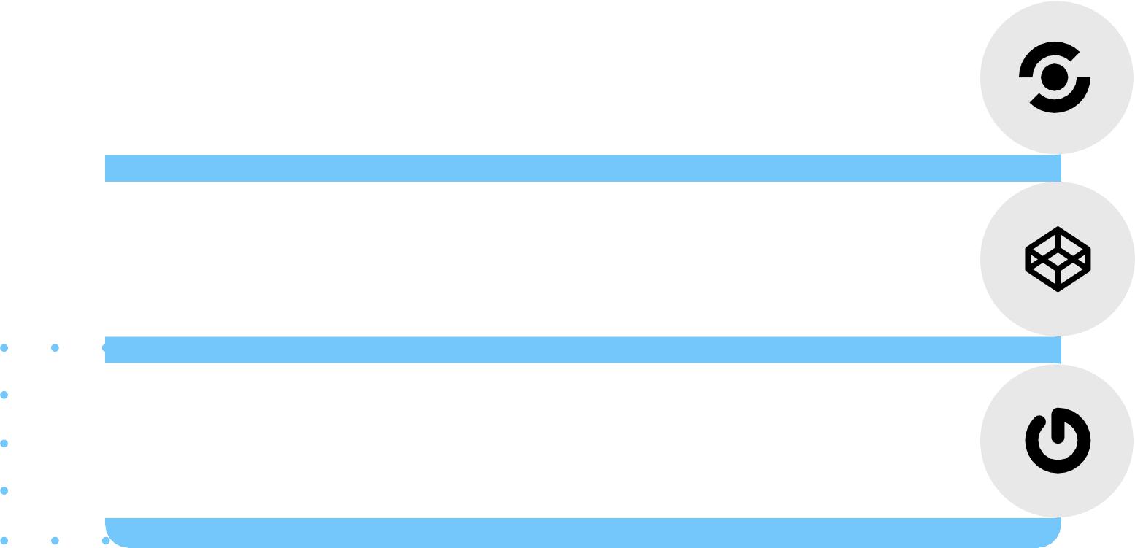
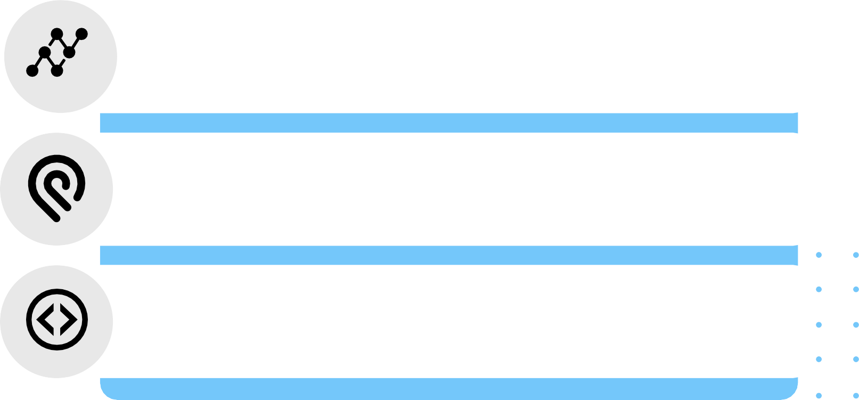
1mg
HealthifyMe
Direct Competitors
Medscape
Doctor 24/7
Indirect Competitors
Portea
Apollo 247

Slide 13

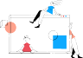






Competitive Advantages
DR.MED
HEALTHIFYME
1MG
MEDSCAPE
Features
50
55
45
60
Price
Fremium
Fremium
Premium
Free
Design
User compatibility

Slide 14
Advantage 1
The landscape differentiates our product from similar ones in design, services, and user compatibility
Advantage 2
The wider range of product features and their easy access is the upper hand of our product over our competitors.
Advantage 3
Adaptable technology suitable for future advancements
Advantage 4
A large number of competitors, hence more provisions for improvement

Slide 15
Utilizing maximum resources to enhance the in-built technologies and services
APPROACH 1
Competitor Approach
APPROACH 2
Reaching out to customers by collecting feedback forms and beta testing
APPROACH 3
Generating marketing strategies that involve customer participation

Slide 16
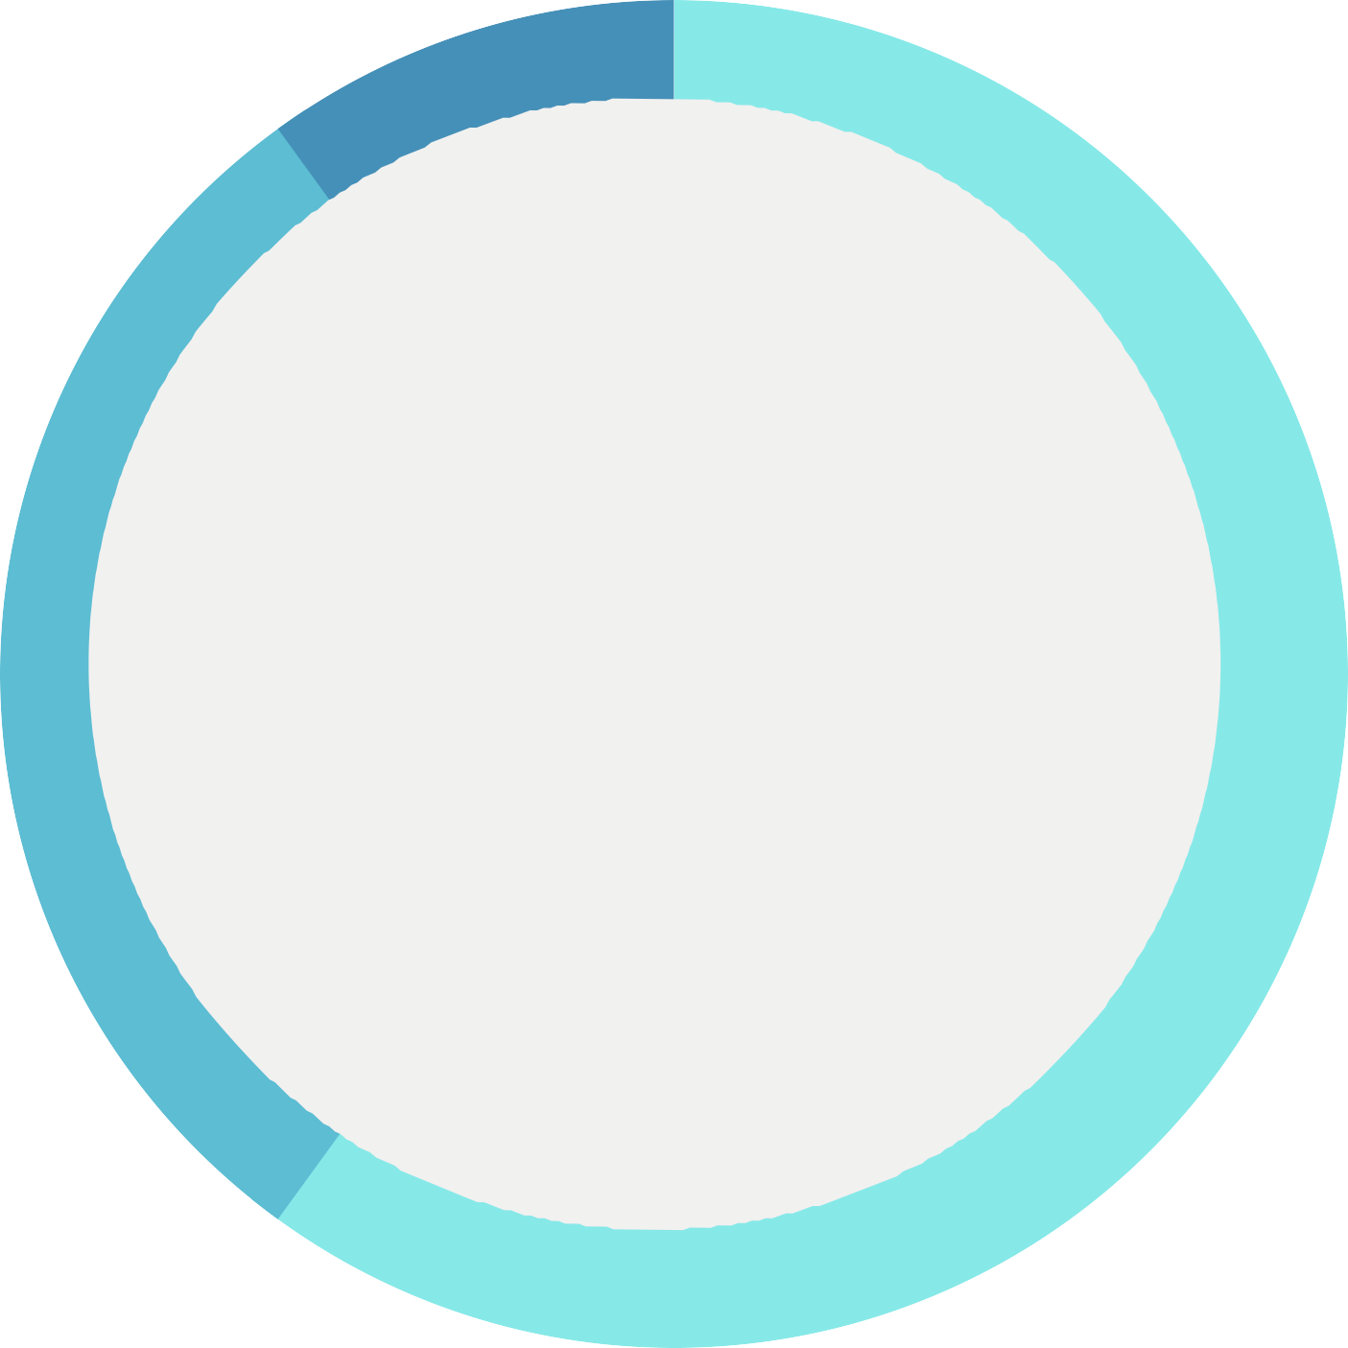
Business Model
R E V E N U E C H A R T
10%
PROMOTIONS
SUBSCRIPTIONS
IN APP PURCHASES
30%
60%

Slide 17
Sponsorship from external organizations
Availability of the product in regional languages
Future Roadmap
Collaborating with medical companies to provide medicine purchase through the app
Connecting with blood banks to enable blood donation services

Slide 18
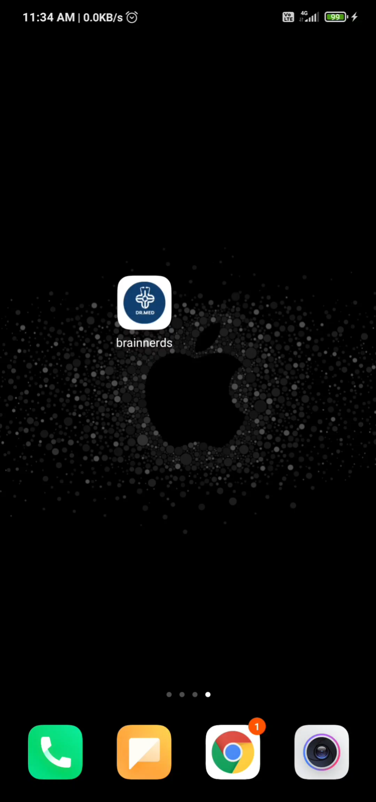
Video Presentation - Flutter App

Slide 19
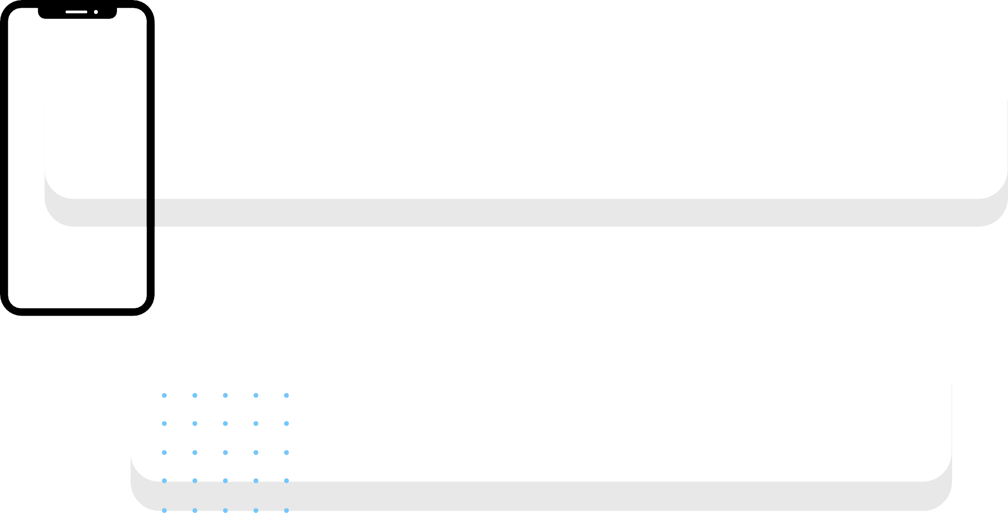
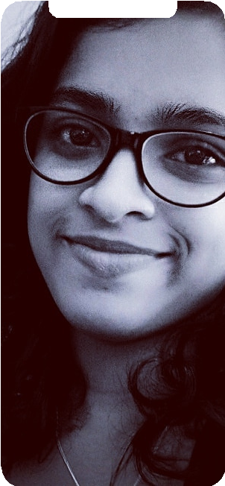
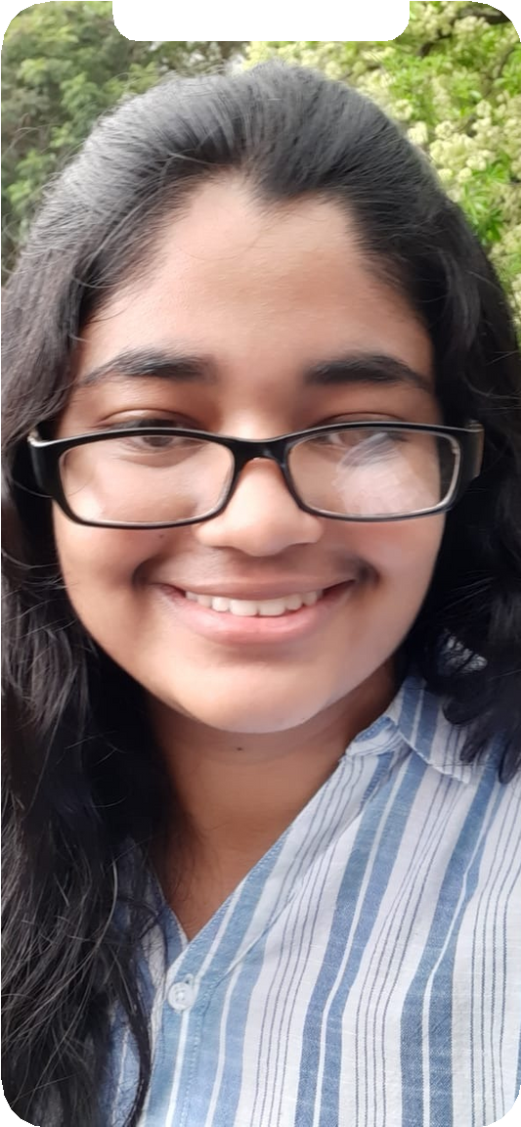
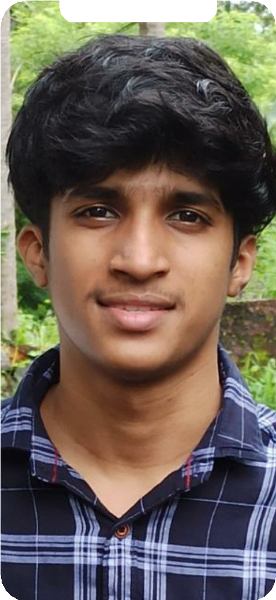
Team Member 1
Josiah Elza Jacob
The Team
Team Member 2
Gouri Krishna
Team Member 3
Advaith M Periyal

Slide 20
Thank You
Drive link to our video presentation : click here

